Slide 1
VCF Spike Protein Variants and ACE2 Population Frequencies
Eddy Huang, Hao Yiu, Nicole Bowers, Mikołaj Mieszko Charchuta, Pooja Singaram,
Michael Hearn

Slide 2
Project Goals
Quantify predicted differences in binding affinity between SARS-Cov-2 S protein and ACE2 in diverse populations
Assess the distribution of S and ACE2 variants in diverse populations
Notes:
Binding affinity is correlated with infectivity. Large scale VCFs would allow for detecting more variants in the S protein

Slide 3
Inspiration
Missense variants in human ACE2 strongly affect binding to SARS-CoV-2 Spike providing a mechanism for ACE2 mediated genetic risk in Covid-19: A case study in affinity predictions of interface variants (2022 Mar 2. doi: 10.1371/journal.pcbi.1009922)
Tested the binding affinity of several ACE2 variants in GNOMAD to one Spike protein, and predicted binding affinity changes for all possible ACE2 missense variants
3DVizSNP: a tool for rapidly visualizing missense mutations identified in high throughput experiments in iCn3D
(2023 Apr 4. doi: 10.1186/s12859-023-05370-5)
Visualize changes in protein structure from a VCF

Slide 4
Previous Works of Note
https://nextstrain.org/
Map of phylogeny and variant detected geographically over time.
https://www.ncbi.nlm.nih.gov/pmc/articles/PMC7439997/
ACE2 coding variants in different populations and their potential impact on SARS-CoV-2 binding affinity
https://bmcmedicine.biomedcentral.com/counter/pdf/10.1186/s12916-020-01673-z.pdf
New insights into genetic susceptibility of COVID-19: an ACE2 and TMPRSS2 polymorphism analysis
https://www.ncbi.nlm.nih.gov/pmc/articles/PMC7886638/
Variants in ACE2; potential influences on virus infection and COVID-19 severity
https://www.nature.com/articles/s41591-023-02483-5
Deep-learning-enabled protein–protein interaction analysis for prediction of SARS-CoV-2 infectivity and variant evolution

Slide 5
Approach
Identify VCF samples with spike(S) protein and geolocation metadata
Extract and merge the data from Athena
Find nonsynonymous SNPs in S protein (from SARS-CoV-2 VCFs) and nonsynonymous SNPs in the ACE2 receptor (from 1kGP project VCFs)
Calculate binding affinity between S protein and ACE2 variants
Visualize S protein variants geographically with binding affinity data

Slide 6
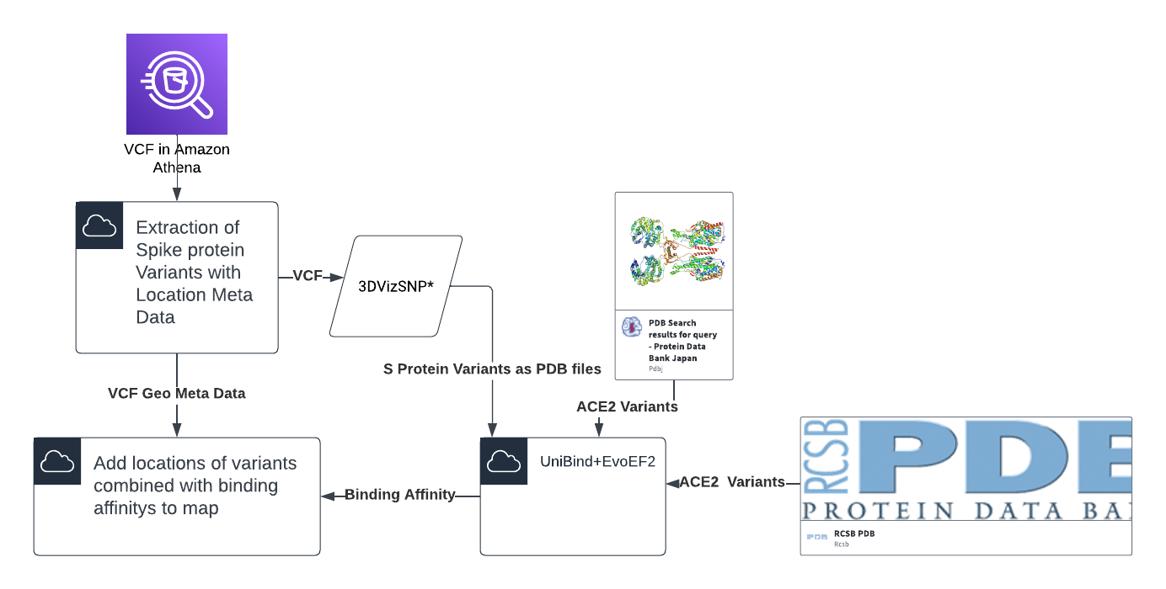

Slide 7
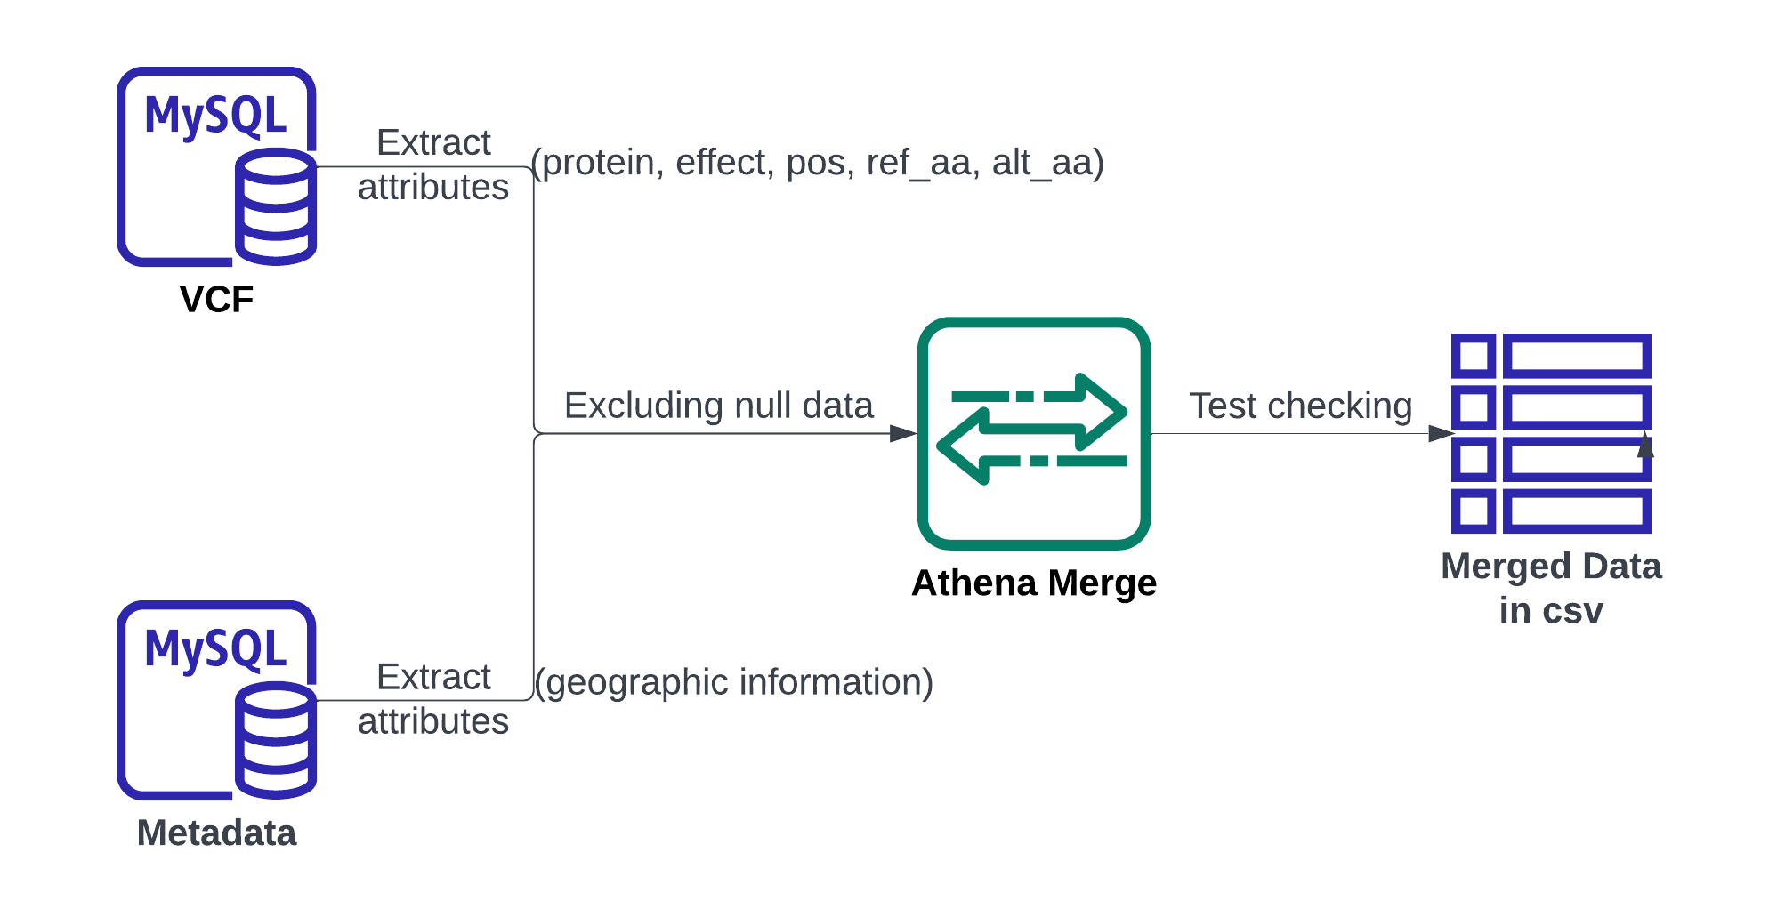
Data Preprocessing
Data availability: https://github.com/NCBI-Codeathons/vcf-4-population-genomics-team-hearn/blob/main/data/merged.txt

Slide 8
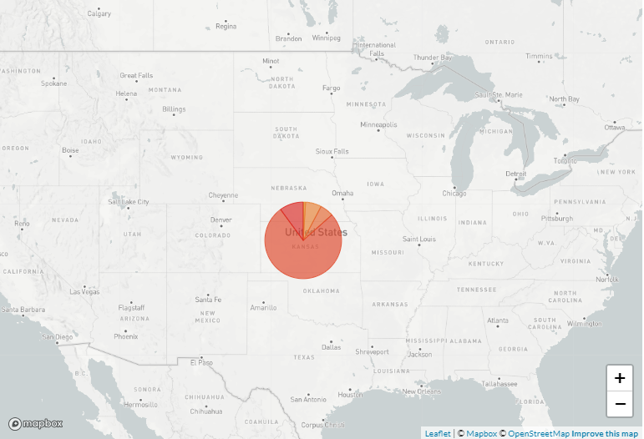
Next Strain Variant Proportions
https://nextstrain.org/ncov/open/global/6m?dmin=2023-01-26

Slide 9
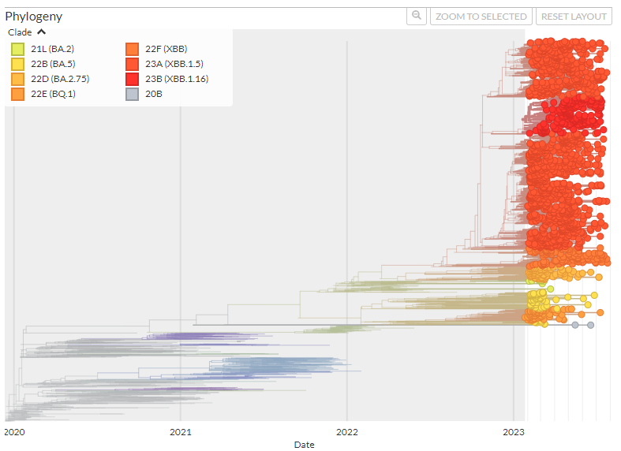
Next Strain Phylogeny
https://nextstrain.org/ncov/open/global/6m?dmin=2023-01-26

Slide 10
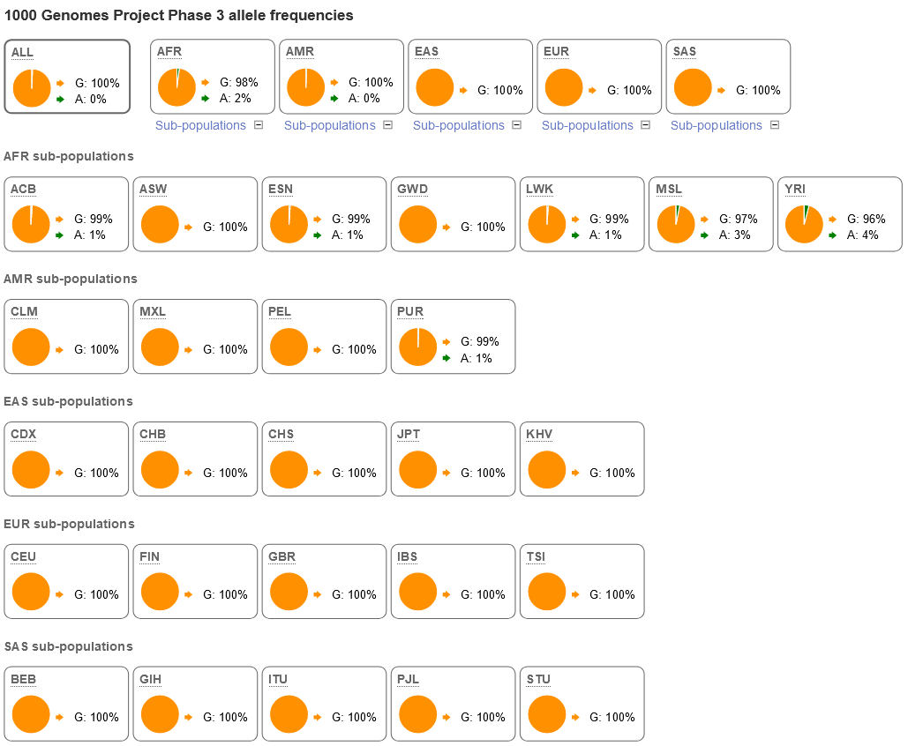
ACE2
Rs147311723
p.Leu731Phe
Even the most common variant in the 1kGP set is relatively rare, but noticeable differences in allele frequencies between sub-populations

Slide 11
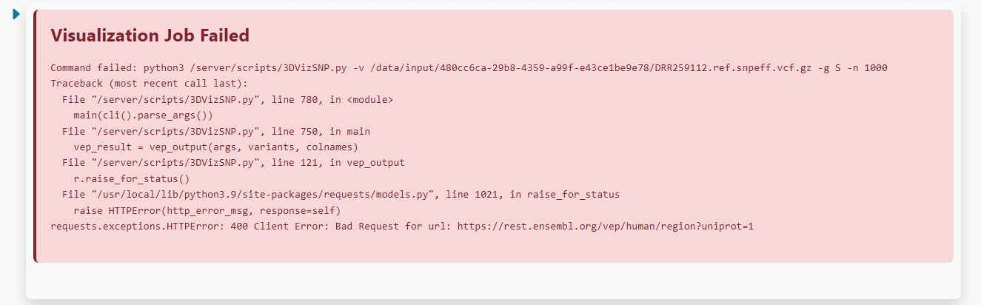
Improvements on 3DvizSNP
We intended to use the program 3DvizSNP in order to process the Covid VCF variants. Our intention was to use the tool to create the protein variants and get .pdb files to check binding affinity. It was written with specificity to the human genome but may benefit from an alternate version made allowing viral genomes as well.

